Slide 1
The basics of Machine learning
Eago, Kai Yang
Assistant Professor
Dept of Government and Public Administration
Lingnan University, HK
February 12, 2025

Slide 2
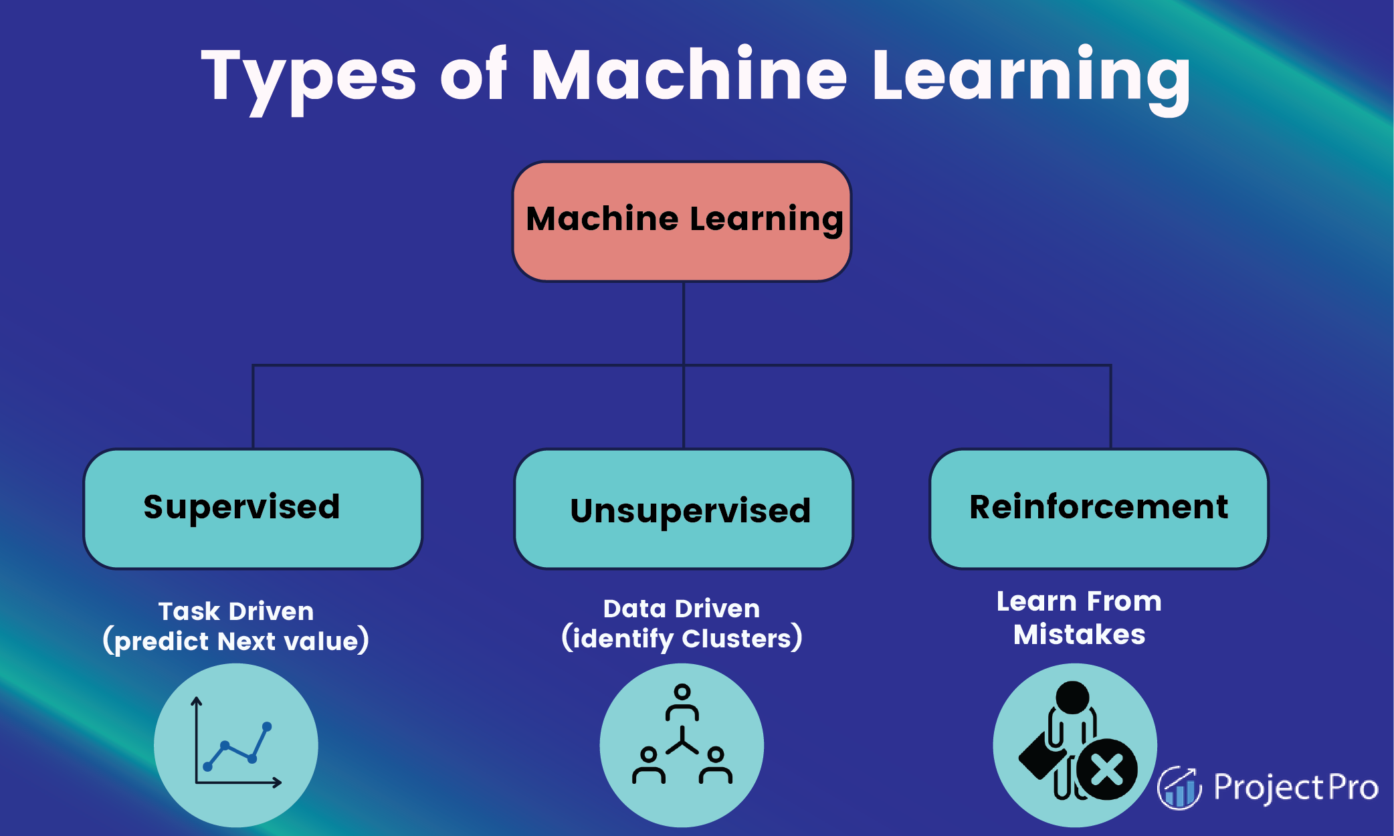
Machine learning
Notes:
https://www.projectpro.io/article/types-of-machine-learning/623

Slide 3
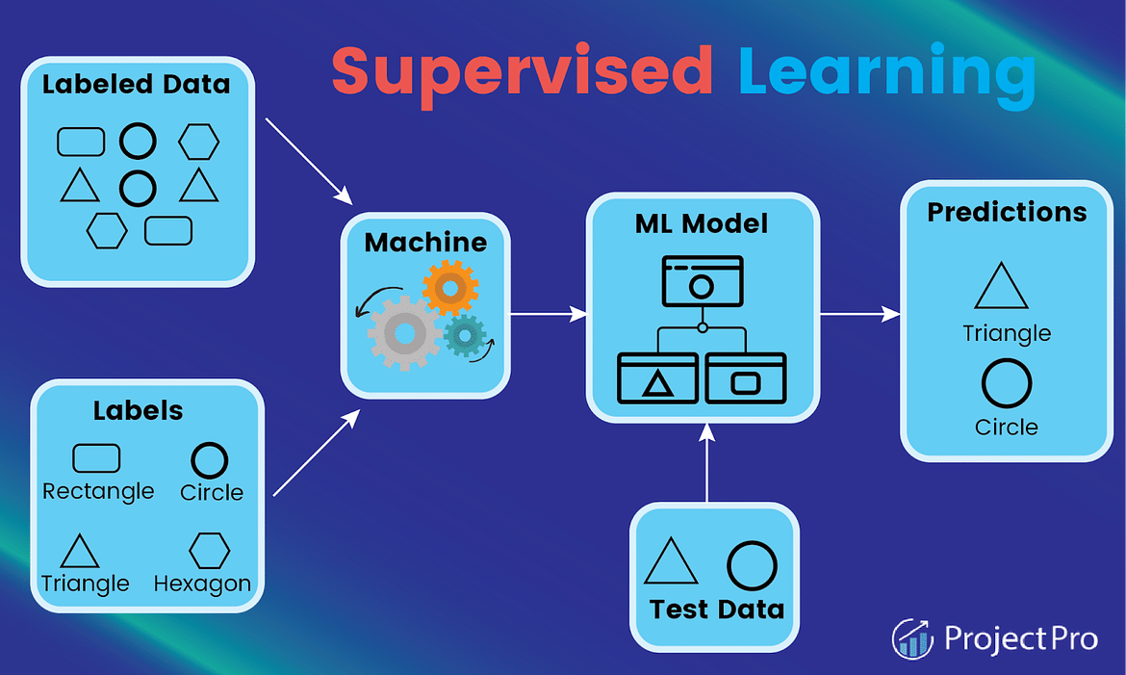
I. Supervised Learning 監督學習

Slide 4
1.1 classification
Predicts the label of a class
Predict the dataset's categories
Example: "Yes" or "No“
Commonly Used Algorithms:
Decision Tree Algorithm
Logistic Regression
Random Forest Algorithm
Support Vector Machine Algorithm

Slide 5
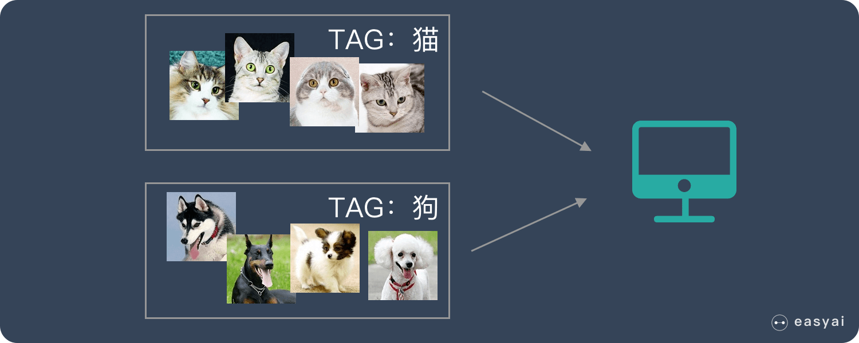
Image detection
Notes:
https://blog.csdn.net/qq_35789269/article/details/120212409

Slide 6

Facial recognition

Slide 7
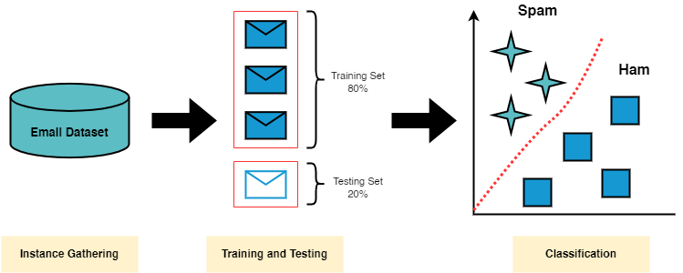
Spam Detection
Notes:
https://medium.com/@alinatabish/machine-learning-techniques-for-spam-detection-in-email-7db87eb11bc2

Slide 8
1.2 regression
Predicts the numerical label/continuous variables
Example: weather prediction
Commonly used algorithms:
Decision Tree Algorithm
Lasso Regression
Multivariate Regression Algorithm
Simple Linear Regression Algorithm

Slide 9
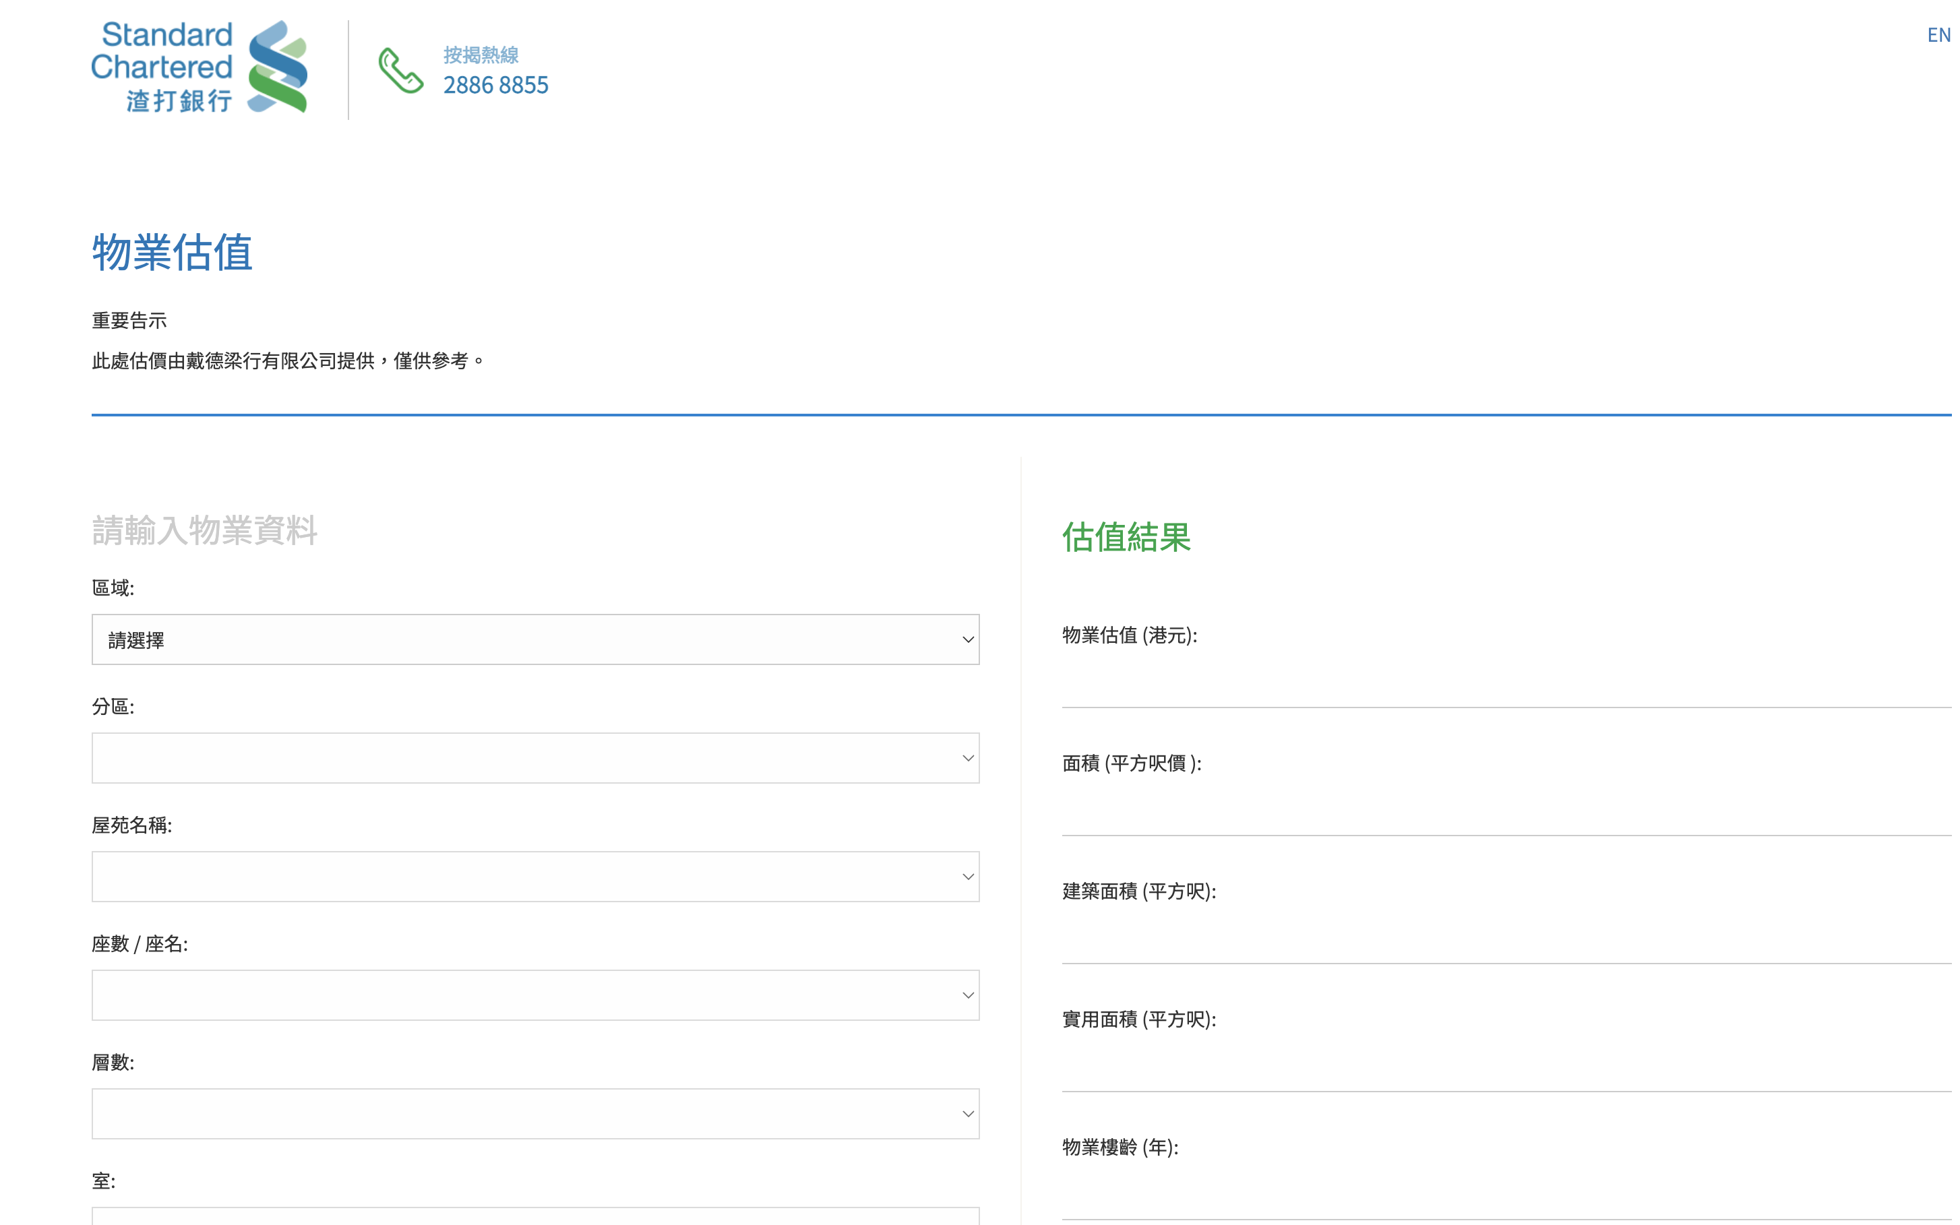
House price prediction
https://www.sc.com/hk/zh/others/property-valuation.html
Notes:
https://www.sc.com/hk/zh/others/property-valuation.html

Slide 10
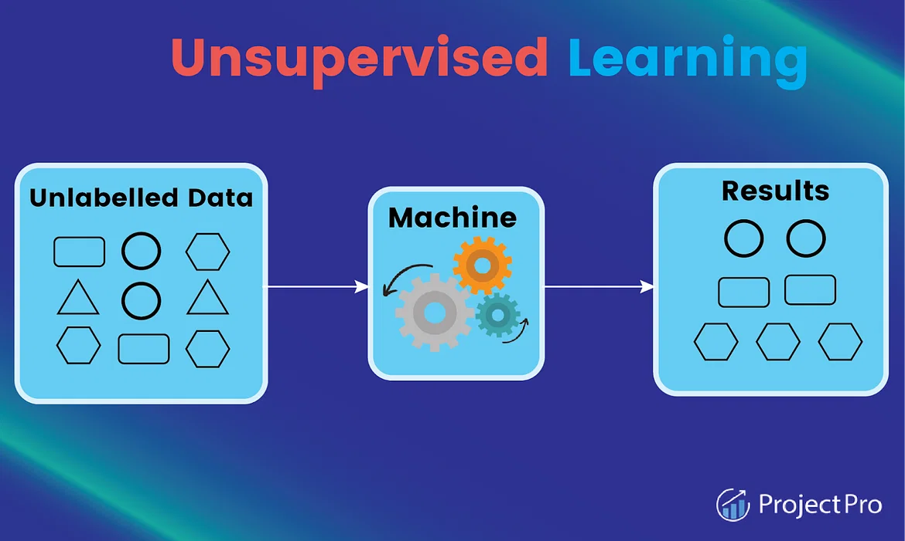
2. unSupervised Learning非監督學習

Slide 11
2.1 association
Finds relations between (independent) variables in a large dataset
Goal: discover and map data dependent on the other to produce maximum profit

Slide 12
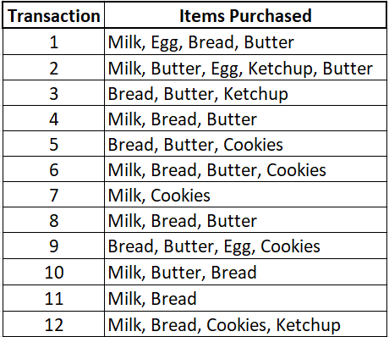
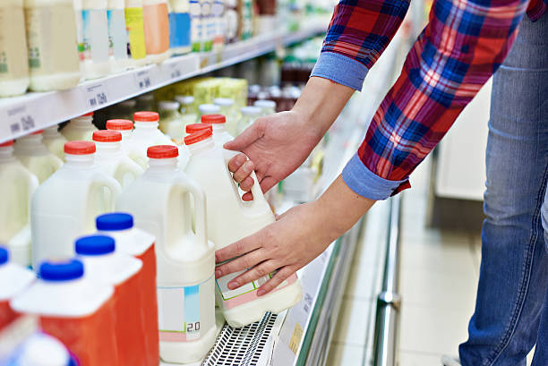
Supermarket Market Basket Analysis
30% of transactions contain bread, butter, and milk, and
80% of customers who bought bread and butter also bought milk

Slide 13
2.2 clustering
A method of grouping each set of similar objects into a cluster
Goal: discover inherent groups from the dataset
Example: retail marketing

Slide 14
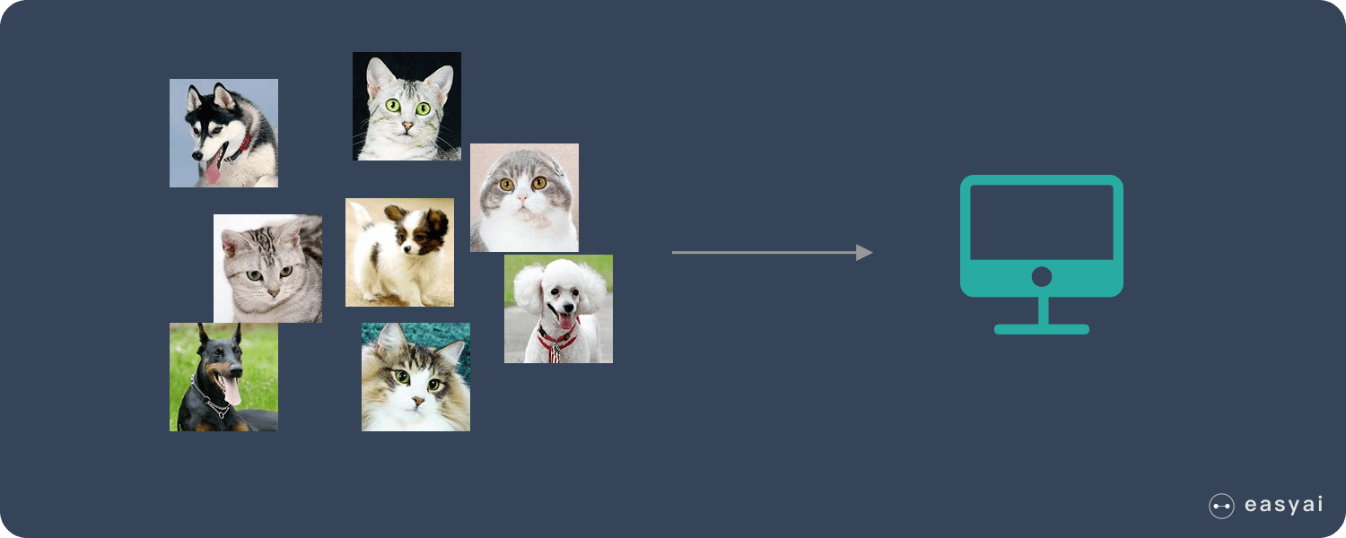
Image clustering without reference

Slide 15
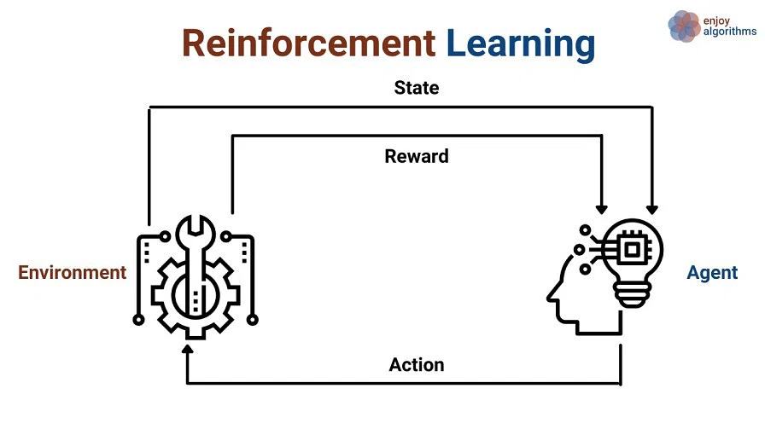
3. Reinforcement Learning強化學習

Slide 16
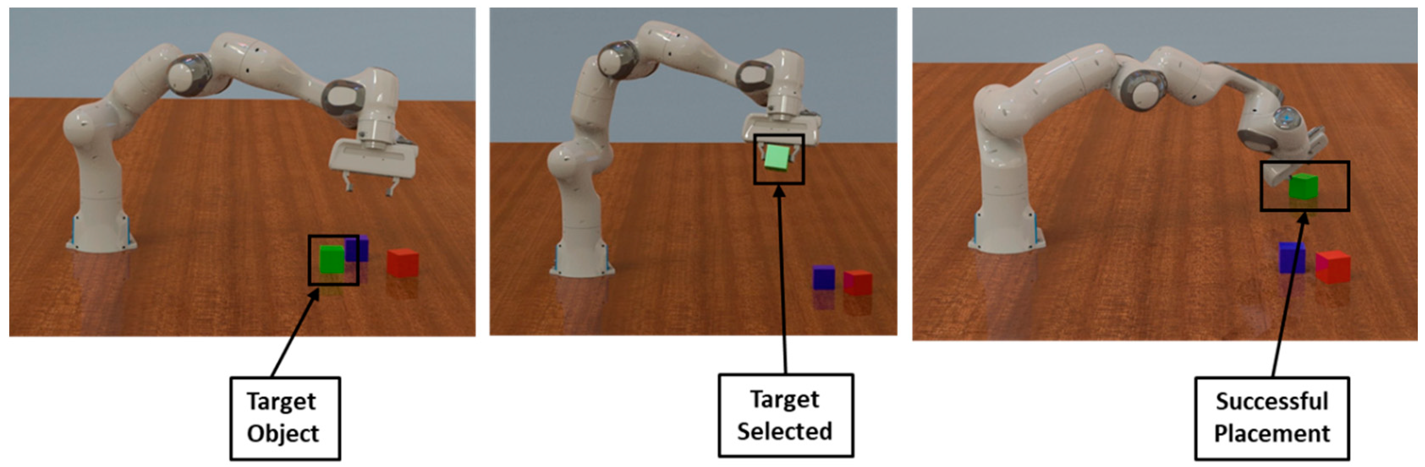
Robotics training
Notes:
https://www.mdpi.com/2218-6581/10/3/105

Slide 17
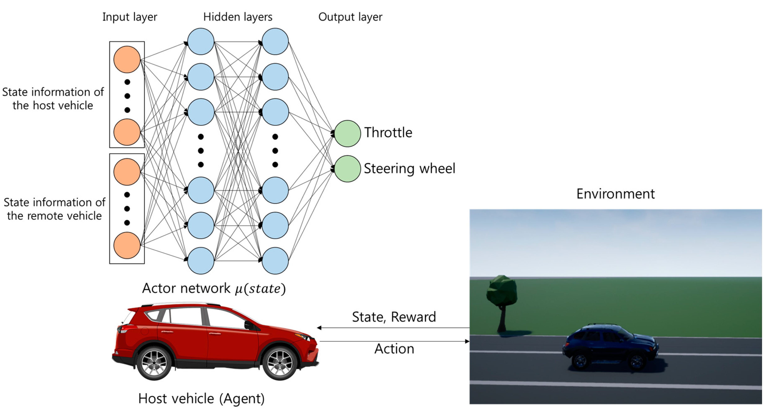
Self-driving Automobiles
Notes:
https://www.mdpi.com/2079-9292/8/5/543

Slide 18
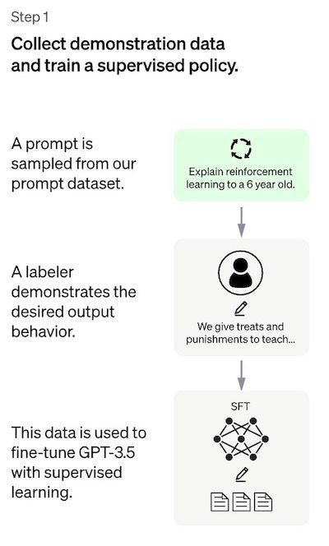
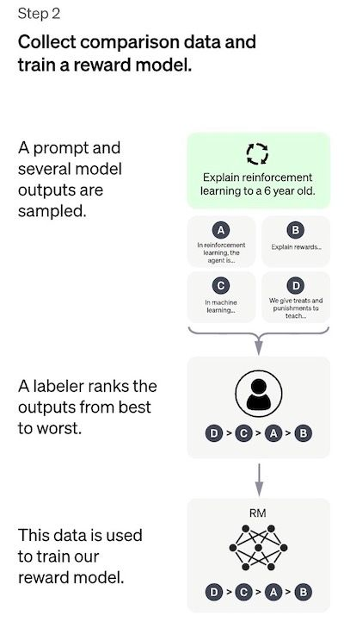
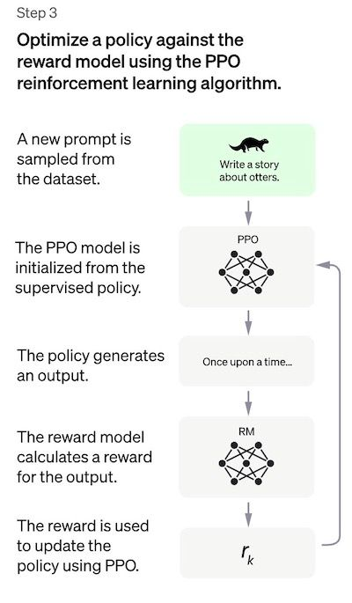
Chatgpt (supervised+reinforcement learning)
Notes:
https://www.assemblyai.com/blog/how-chatgpt-actually-works/

Slide 19
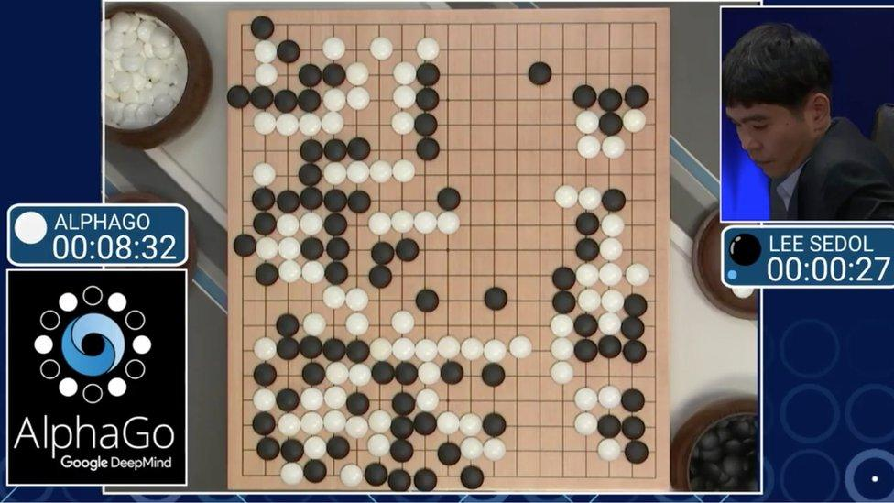
Chess-playing

Slide 20
Introduction to the Virtual Issue: Machine Learning in Political Science
https://www.cambridge.org/core/services/aop-file-manager/file/5c348274e401b41903dae11b/PAN-VSI-Intro-0119-Machine-learning.pdf
Machine Learning for Social Science: An Agnostic Approach
https://www.annualreviews.org/doi/pdf/10.1146/annurev-polisci-053119-015921?download=true

Slide 21
Reference list
Brady, Henry E., and David Collier, eds. Rethinking social inquiry: Diverse tools, shared standards. Rowman & Littlefield Publishers, 2010.
Creager A.N.H., Lunbeck, J., Wise, Matthew N. Science without laws: Model systems, cases, exemplary narratives. Duke University Press, 2007.
Goertz, Gary, and James Mahoney. A tale of two cultures: Qualitative and quantitative research in the social sciences. Princeton University Press, 2012.
Mahoney, James. "After KKV: The new methodology of qualitative research." World Politics 62, no. 1 (2010): 120-147.
Caldarelli, Guido, Alessandro Chessa, Fabio Pammolli, Gabriele Pompa, Michelangelo Puliga, Massimo Riccaboni, and Gianni Riotta. "A multi-level geographical study of Italian political elections from Twitter data." PloS one 9, no. 5 (2014): e95809.
Crosas, Merce, Gary King, James Honaker, and Latanya Sweeney. "Automating open science for big data." The ANNALS of the American Academy of Political and Social Science 659, no. 1 (2015): 260-273.
González-Bailón, Sandra, and Georgios Paltoglou. "Signals of public opinion in online communication: A comparison of methods and data sources." The ANNALS of the American Academy of Political and Social Science 659, no. 1 (2015): 95-107.
Salganik, Matthew J. Bit by bit: Social research in the digital age. Princeton University Press, 2018.
King, Gary, Robert O. Keohane, and Sidney Verba. Designing social inquiry: Scientific inference in qualitative research. Princeton university press, 1994.

